Slide 1
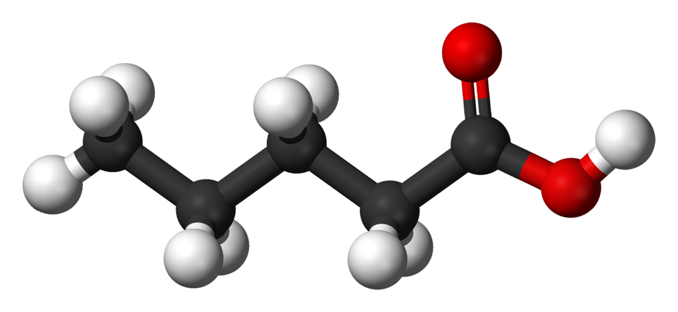
Carboxylic Acids

Slide 2
Carboxylic acids
A carboxylic acid
Contains a carboxyl group, which is a carbonyl group (C=O) attached to a hydroxyl group (—OH).
Has the carboxyl group on carbon 1.
carbonyl group
O
||
CH₃ — C—OH hydroxyl group or CH₃COOH
carboxyl group

Slide 3
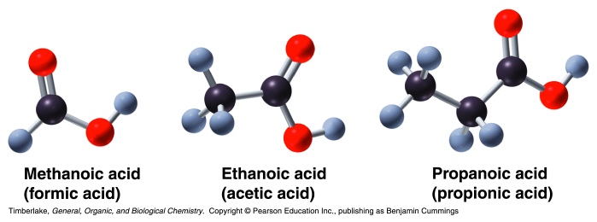
Models of carboxylic acids

Slide 4
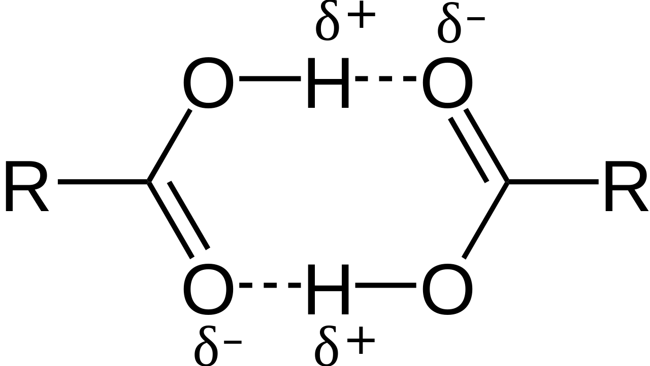
Properties of carboxylic acids
Are strongly polar.
Have two polar groups:
hydroxyl (−OH) and carbonyl (C=O).
The boiling points of carboxylic acids
Are higher than alcohols, ketones, and aldehydes of similar mass.
Are high because they form dimers in which hydrogen bonds form between the polar groups in the two carboxyl groups.
δ

Slide 5
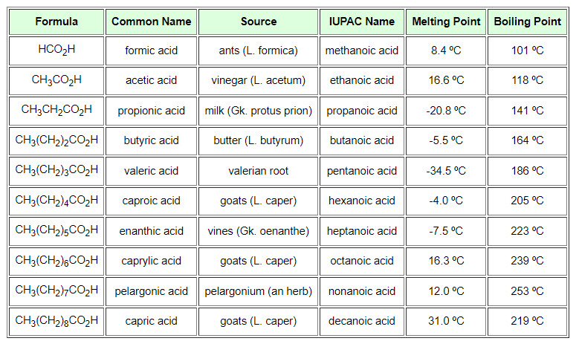
Can you tell what is the nomenclature for carboxylic acids?

Slide 6
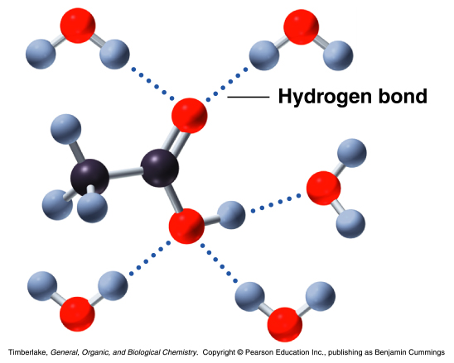
Properties of carboxylic acids
Solubility
They form hydrogen bonds with water
Lose solubility after the carbon chain reaches 4 o 5 carbons.

Slide 7
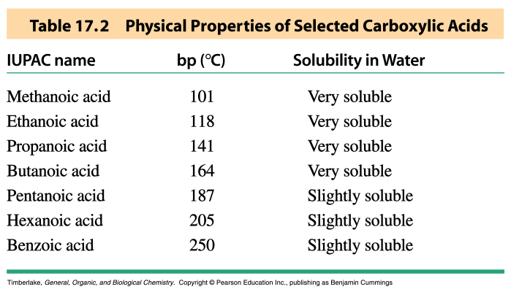

Slide 8
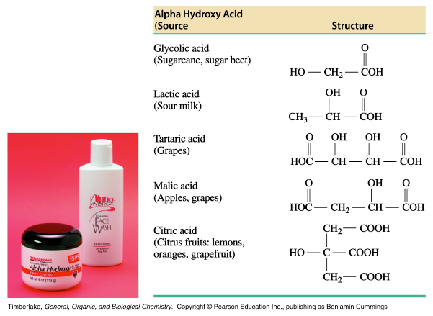
Where can we find carboxylic acids?
Alpha hydroxy acids: in fruits, milks and sugarcane. Used as weak acids in skin care products.

Slide 9
Where can we find carboxylic acids?
Methanoic acid (formic acid): ants and bee stings
Ethanoic acid (acetic acid): vinegars
Propanoic acid: dairy products
Butanoic acid: butter

Slide 10
